Slide 1
SMART ASSISTANCE
Prepared by:
Ghanta Sarfaraz M(130430116031)
Jadeja Harshvardhansinh G(130430116043)

Slide 2
Brief Overview/Abstract
As we all are living in the new era of technology, it is supposed to have everything surrounding us smart and technically advanced.
In this Era everybody use to have a smartphone, and an increasing use of the smart android app strikes us to have everything inside an app.
Smart Assistance is an appointment booking Android app which will be used for booking an appointment with various service providers.
As it is an android app it will provide Easy access as well as user friendly interface.

Slide 3







…CONTINUE
Everybody likes to complete his/her work in time and booking an appointment is one of the way to complete their work in time.
Over a past few years booking an appointment has grown popularity over whole world, many organizations, businesses, universities, hospitals, hairstylist, charter accountant, astrologer etc. uses some web-based online appointment management system which helps them to have their work done on time bases.
List of service Provider are as follow:
Doctor
Beautician
Advocate
Charted accountant
Organization
Corporate company
Astrologer etc.

Slide 4

Why android app?
Well a question may arise that why to use android?
As we all know that now a days everyone use to have an android mobile phones or tablets.
Android phones are emerging faster than any mobile phones in history of Mobile devices.
With the success of android mobile operating system there is also an large development in android applications

Slide 5
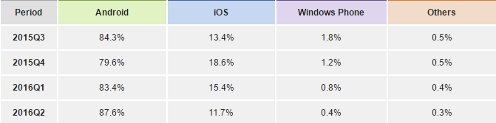
The table shows the worldwide smartphone OS Market Shares
Android dominated the market with an 87.6% share in 2016Q2.
Looking at the success of the android it also seems that android operating system is going to last for many years.
This ratio clearly shows the the users interest in android devices, and developing an app in android is quite more beneficial than any other mobile operating system.

Slide 6
Smart Assistance
Technological era demands for the technical device and that technical device demands for the advance app.
As we all know that doctors, beauticians, advocates etc. every service providers are so busy in handling their patients or customers respectively that handling the queue of them is quite challenging.
And also from users point of view waiting in a queue is bit difficult/irritating.
Hence the app is being developed to solve the above problem in a smart way, by providing easy and reliable access as well as user friendly interface.

Slide 7
Features of the app
In-app appointment booking & confirmation
In-app notification about your turn
Manage queue of clients in waiting for professional Service Providers
Reduces waiting time
Stress free

Slide 8
…Continue
Client can also pay online, if they wish
Provide facility to service provider to create the profile and rate card
Easy to book
One click super easy turn intimation to client
User friendly
Provide facility to client to write review about their experience.

Slide 9
Technology used
JSON: The JSON format is often used for serializing and transmitting structured data over a network connection. It is used primarily to transmit data between a server and web application, serving as an alternative to XML.
PHP: PHP is mainly focused on server-side scripting
TWITTER BOOTSTRAP: Bootstrap is a free and open-source front-end web framework for designing websites and web applications

Slide 10
DATA DICTIONARY(Database)
Client
Client [person who request appointment]
No | Name | Datatype | constraint | Remarks
1 | Id | Integer | Primary key | Uniquely identify each user
2 | Name | Text
3 | Gender | Boolean
4 | Contactno1 | Text |  | Not null
5 | Email | Text
6 | Username | Text
7 | Password | Text

Slide 11
2. ADMIN
Administrator [MySQL]
No | Name | Datatype | constraint | Remarks
 | Id | Integer | Primary key | Uniquely identify each user
2. | Username | Text
3. | Password | Text
4. | Question | Text
5. | Answer | Text
6. | Last_login_date | Date |  | Last login date of administrator

Slide 12
3. Category
Category [type of service provider] 1
 | Id | Integer | Primary key | Uniquely identify each record
2. | Title | Text | Unique, not null | Category name of service provider such as doctor, architect , hair dresser, school college principal, police superintendent
3. | Description | Text |  | Category description

Slide 13
4. Service Provider
Service_provider [person who give appointment]
1 | Id | Integer | Primary key | Uniquely identify each record
2 | Categoryid | Integer | Foreign key
3 | Title | Text | Unique, not null | Company name/shop name of service provider
4 | Slogan | Text | Not null | Slogan of service provider
5 | Logo | Text | Not null | Logo of service provider
6 | Address1 | Text
7 | City | Text
8 | State | Text
9 | Contactno1 | Text |  | Not null
10 | Contactno2 | Text |  | Not null
11 | Email | Text
12 | Username | Text
13 | Password | Text

Slide 14
5. Appointment info
Appointment_info
 | Id | Integer | Primary key | Uniquely identify each record
2. | Service_providerid | Integer | Foreign key
3. | Service_detail | Text |  | Detail of service
4. | Amount | Int |  | Tentative service amount
5. | Duration | Int |  | Duration of service in minute

Slide 15
6. Appointment book
Appointment_book 5
 | Id | Integer | Primary key | Uniquely identify each record
2. | Clientid | Integer | Foreign key | Foreign key of client table
3. | Appointment_info_id | Integer | Foreign key
4. | Service_providerid | Integer | Foreign key
5. | bookdate | Date |  | Book date of appointment
6. | meetingdate | Date |  | Date of appointment
7. | time | Text |  | Time of appointment
8. | Status | Text |  | 1=requested 2=accepted 3=rejected

Slide 16
7. Review
Review
 | Id | Integer | Primary key | Uniquely identify each record
2. | Clientid | Integer | Foreign key
3. | Service_providerid | Integer | Foreign key
4. | Fdate | Date | Not null | Date of feedback
5. | Title | Varchar(128) | Not null | Title of the feedback
6. | rating | Varchar(128) | Not null | Description of feedback

Slide 17
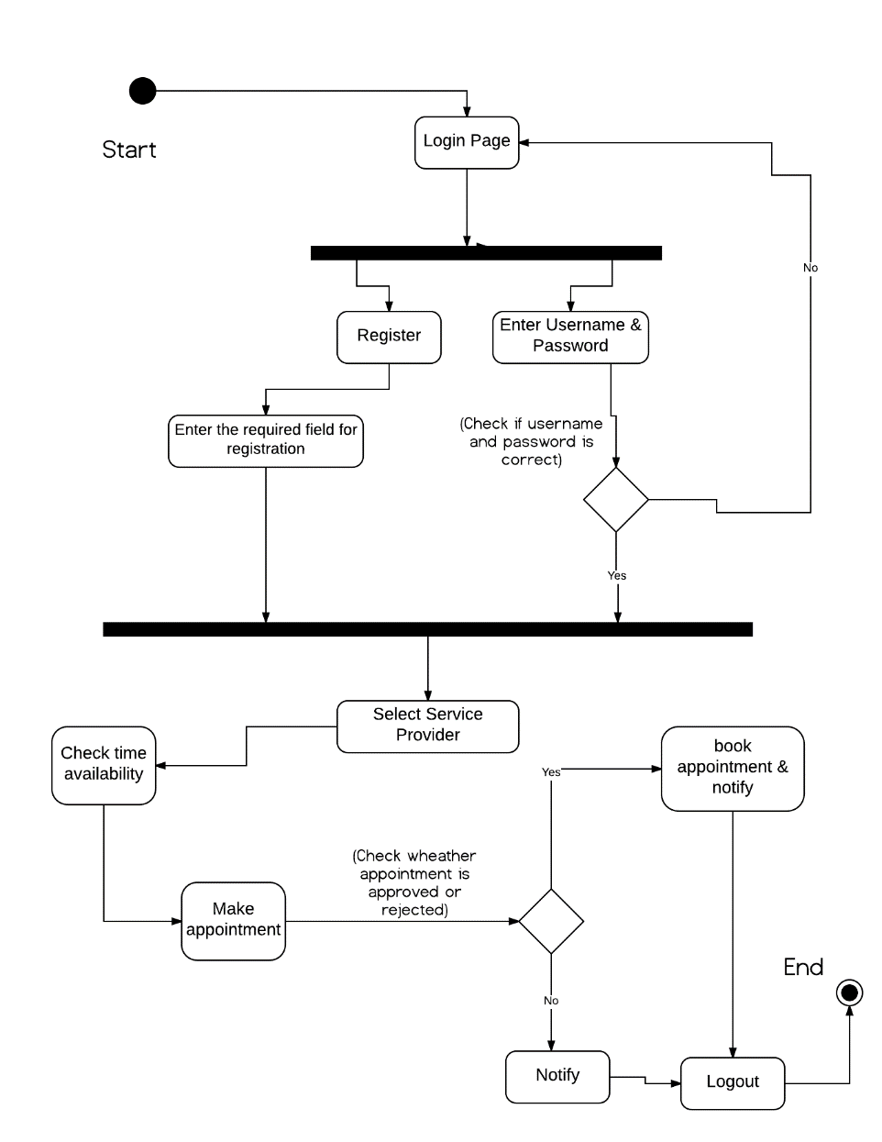
UML Diagrams
1)
Activity Diagram

Slide 18
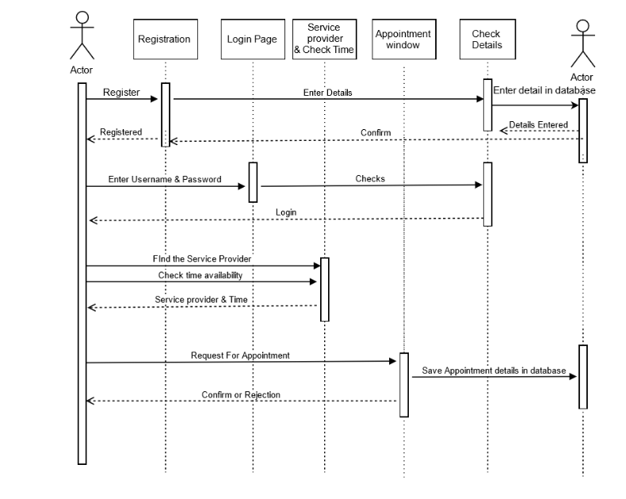
2) Sequence Diagram

Slide 19
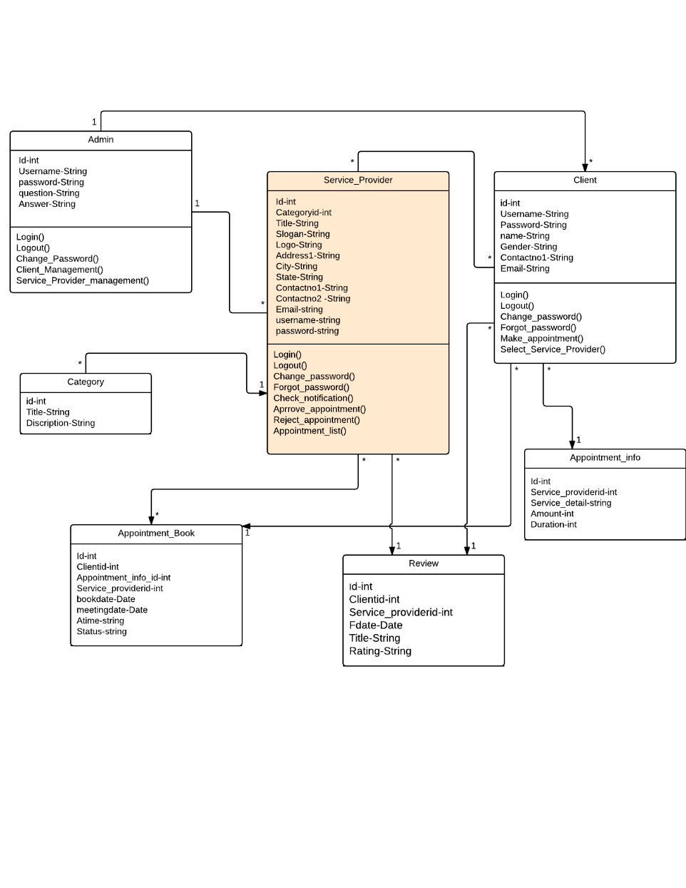
3) Class Diagram

Slide 20
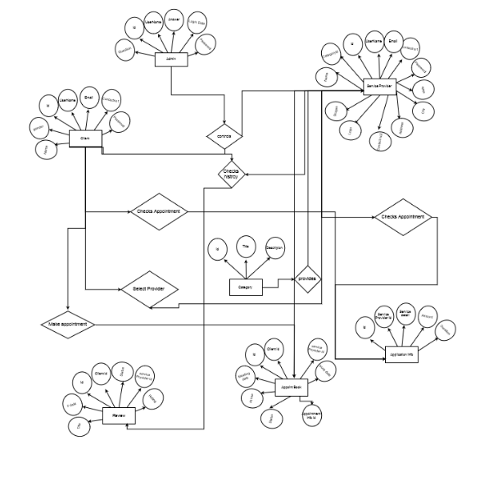
4) E-R Diagram

Slide 21
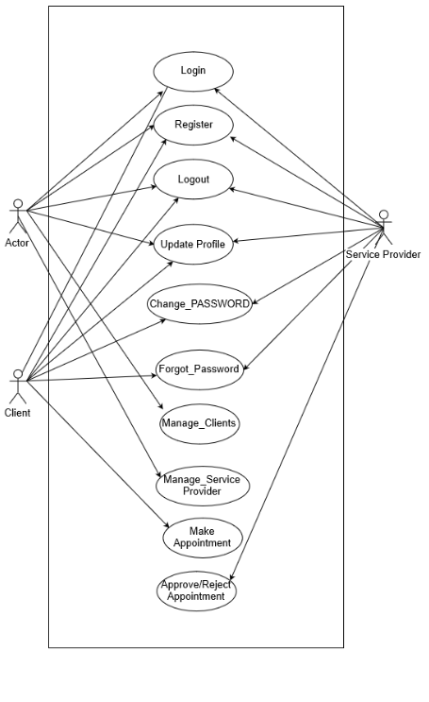
5)
Use-Case Diagram

Slide 22
THANK YOU

